Slide 1



Slide 2
Polygenic Disorders
Caleb Lareau

Slide 3
Overview
Motivation
Authors
Polygenic Risk Scoring
Power et al.
Future work
LD Score Regression
LD Hub

Slide 4
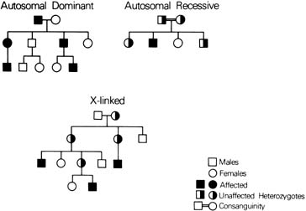

Slide 5
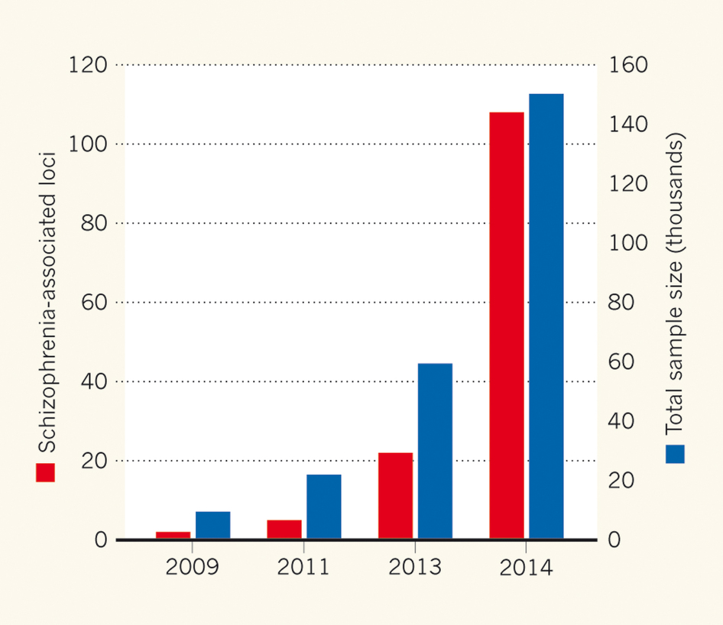

Slide 6
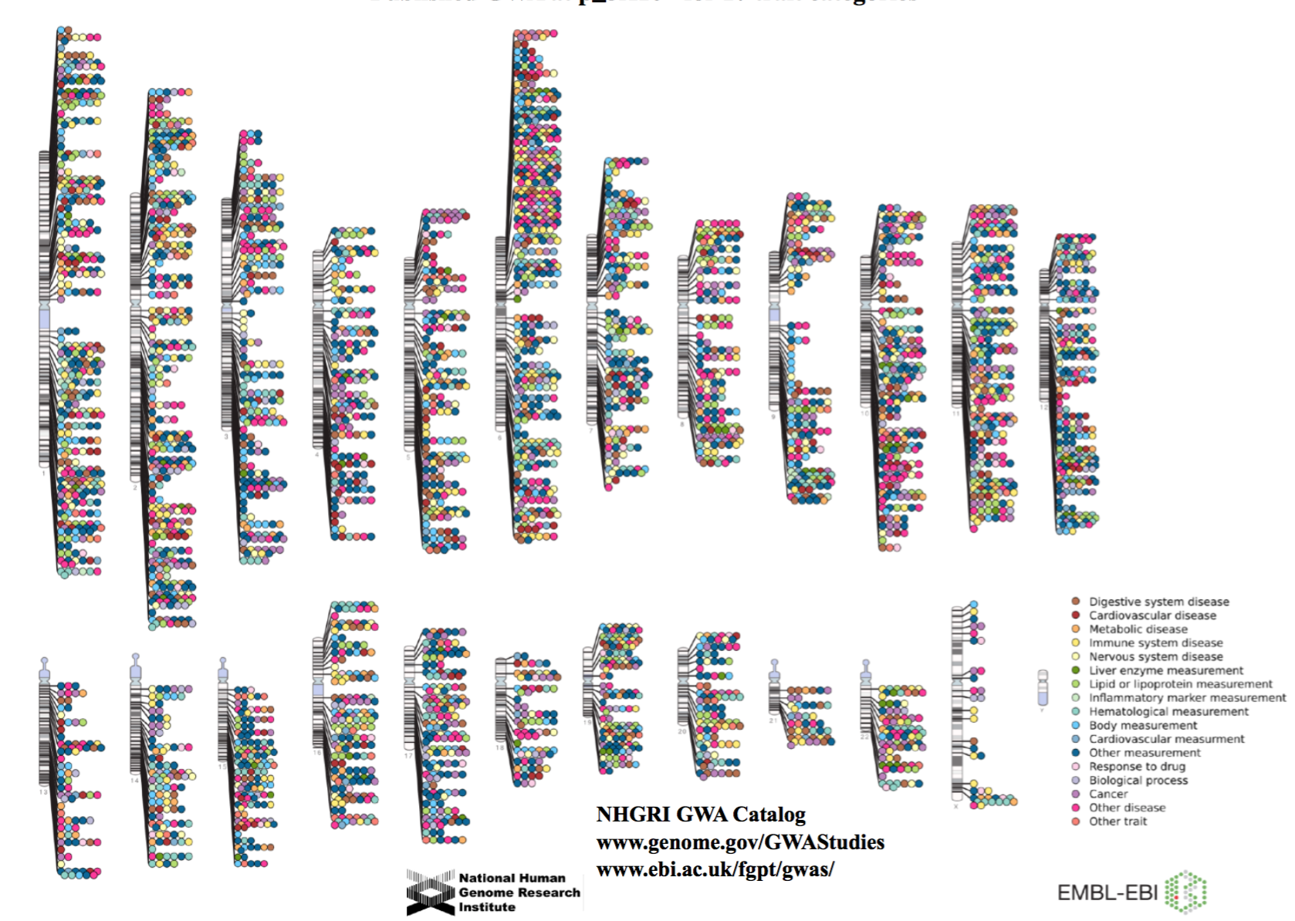

Slide 7
From GWAS…
How do we predict risk of disease?
Is this risk clinically actionable?
Can genetics be used to inform treatment?
Precision Medicine
Can genetic profiles predict human attributes?

Slide 9

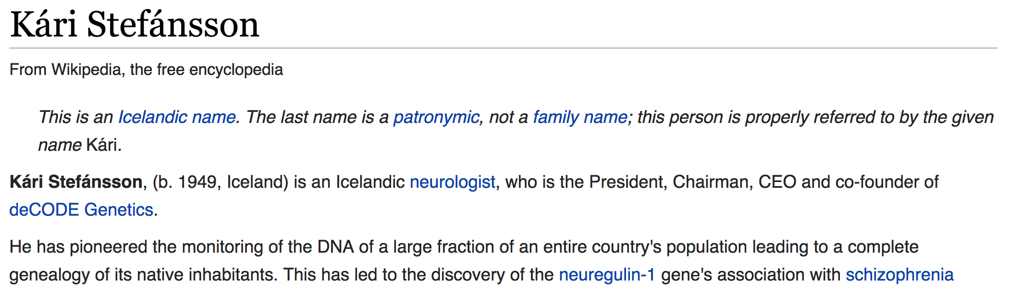

Slide 10
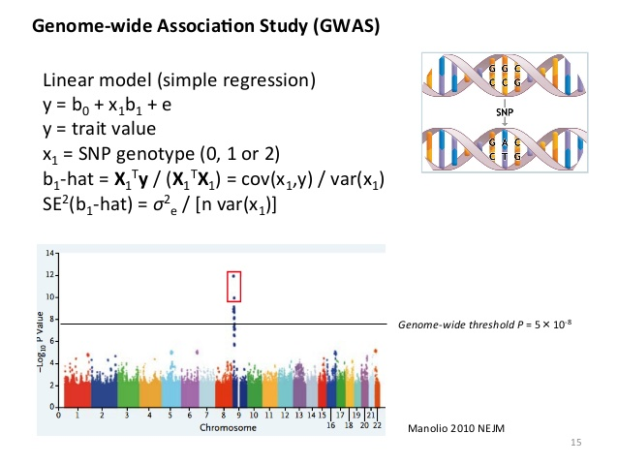

Slide 11
Polygenic Risk Scoring
Methodology that computes one score per individual based on genetic risk in another population
Variant Thresholding
Linkage Disequilibrium (“Clumping”)
Continuous and discrete outcomes

Slide 12
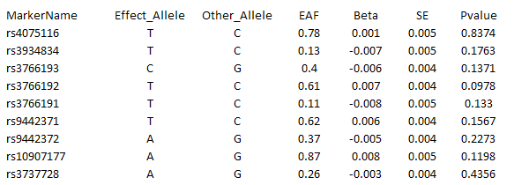
GWAS Results
show PRS on board…

Slide 14
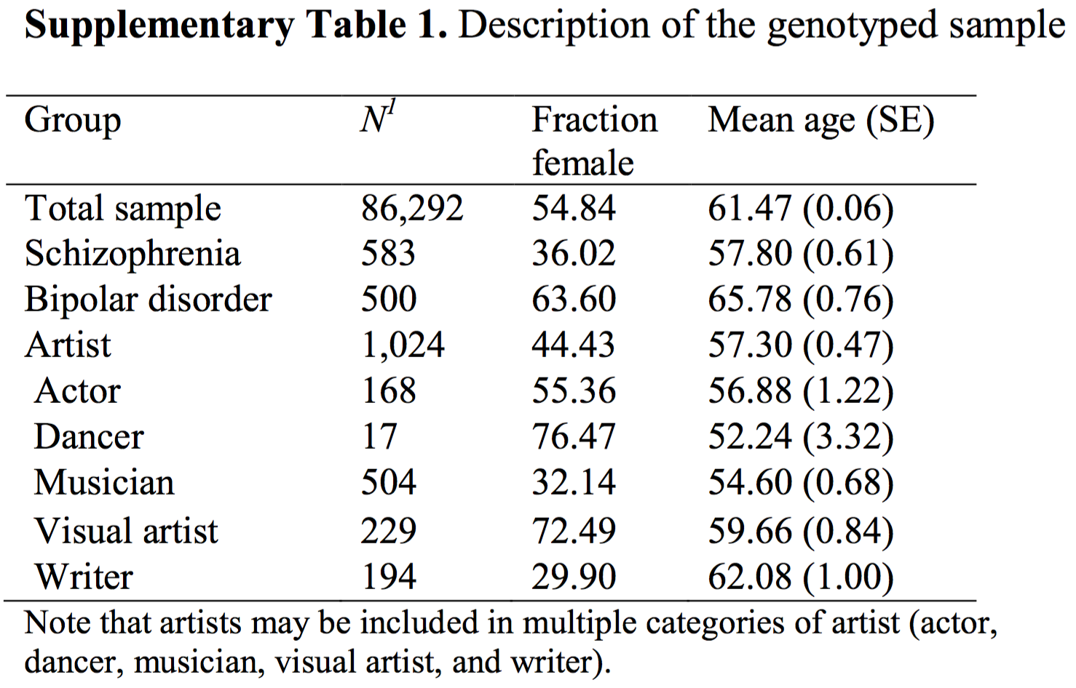

Slide 15
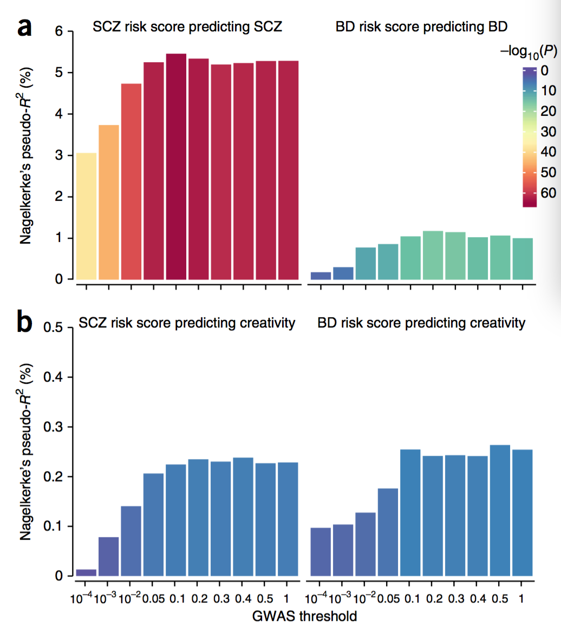

Slide 16
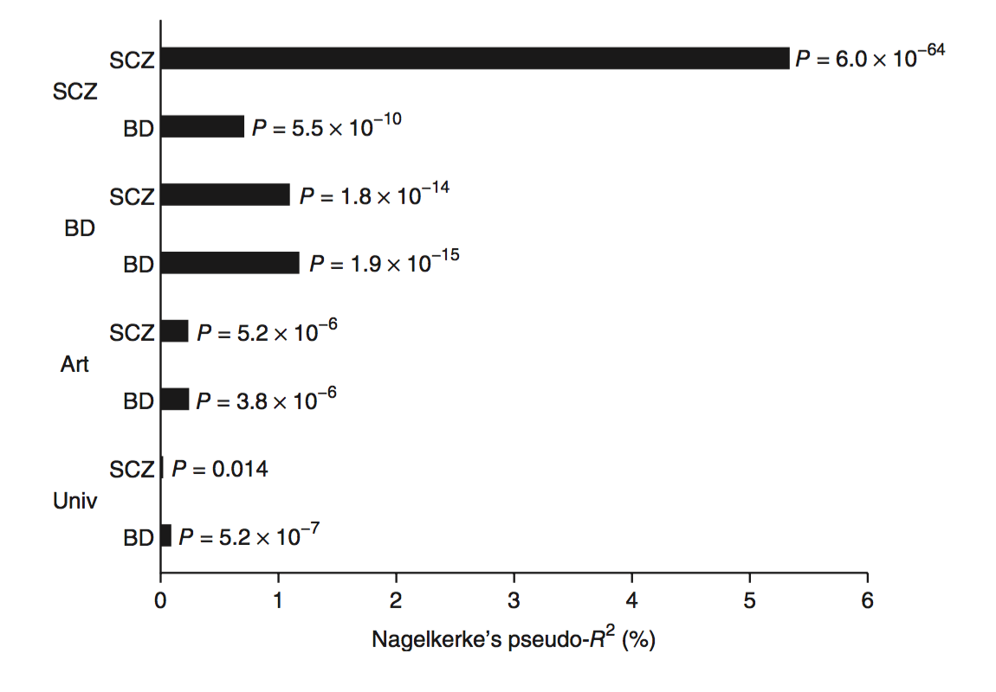

Slide 17
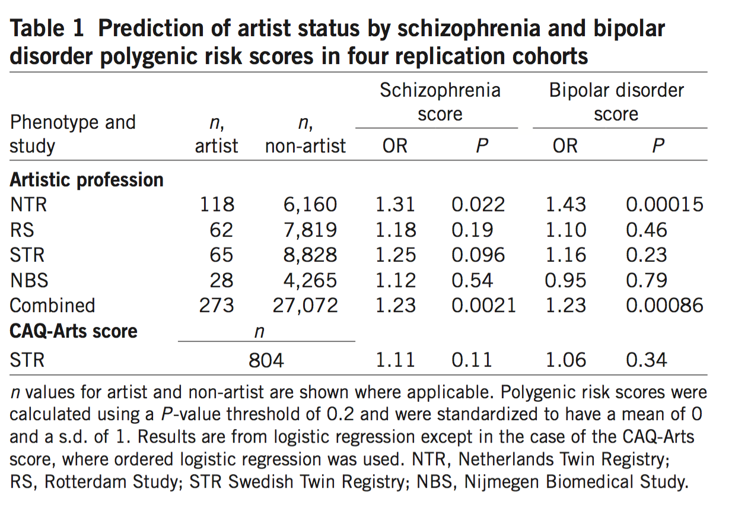

Slide 18
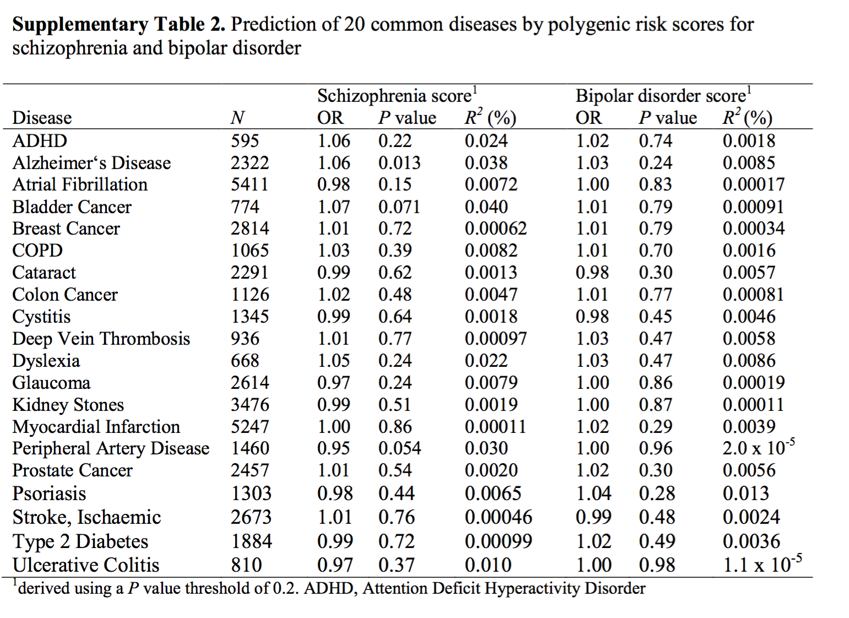

Slide 19
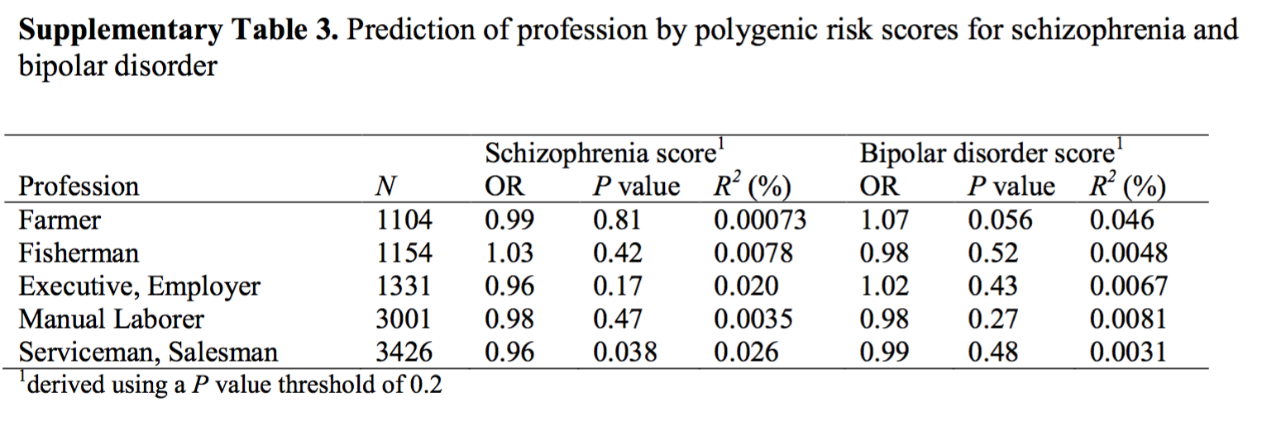

Slide 20
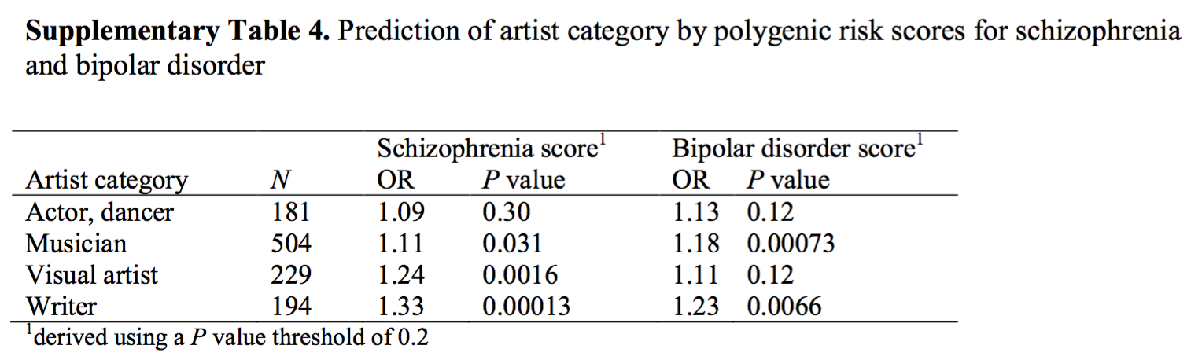

Slide 21
What else have PRS taught us?

Slide 22
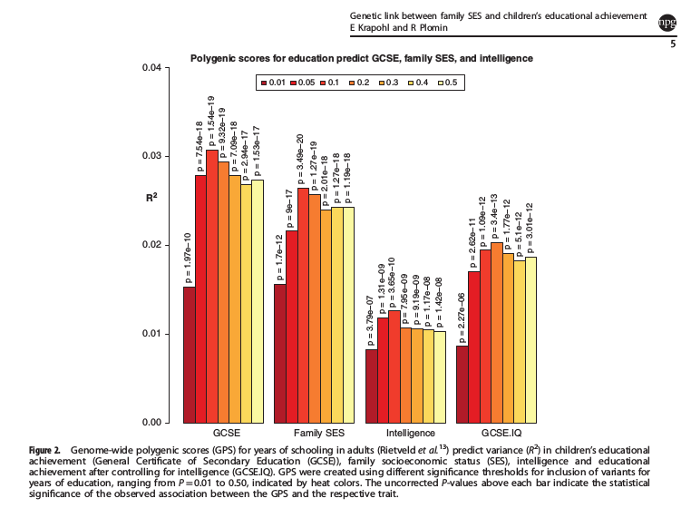
Mediated by intelligence …

Slide 23
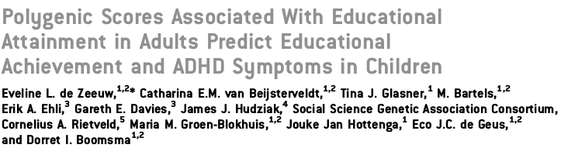
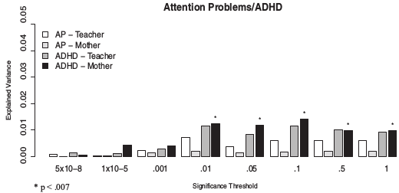
and ADHD!

Slide 24
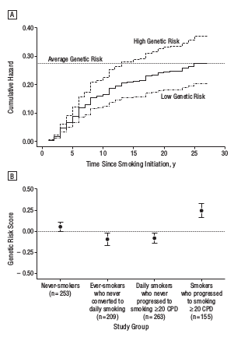
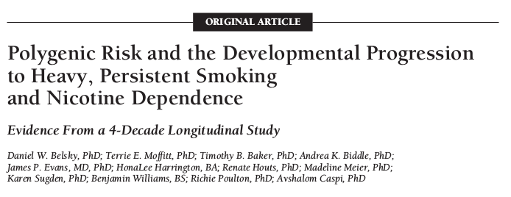

Slide 25
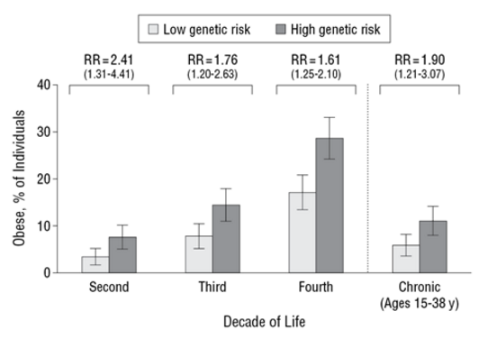
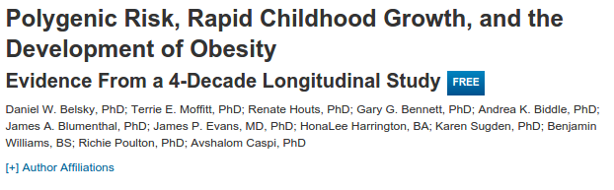
BMI

Slide 26
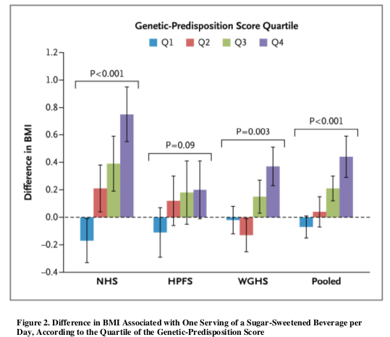
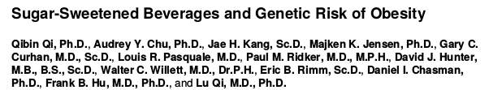

Slide 27
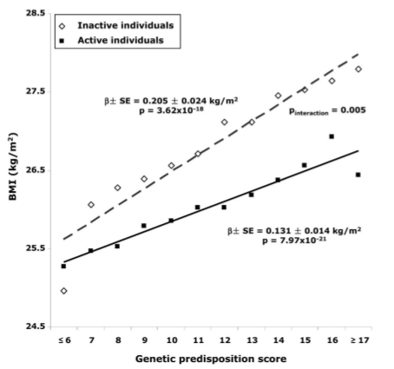
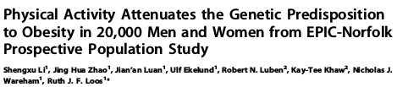

Slide 28
EVE Analysis Consortium
Genetic predisposition to certain inflammatory diseases predicts severe asthma attacks (binary) in cohort of asthmatic patients
Immunospecific medicines for asthma subpopulations?

Slide 29
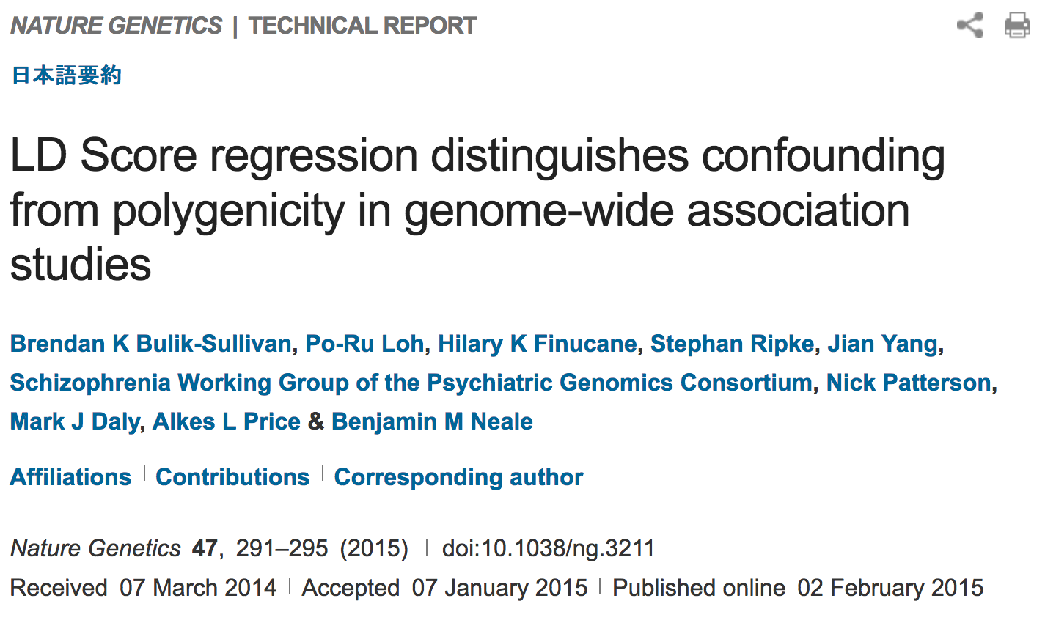

Slide 30
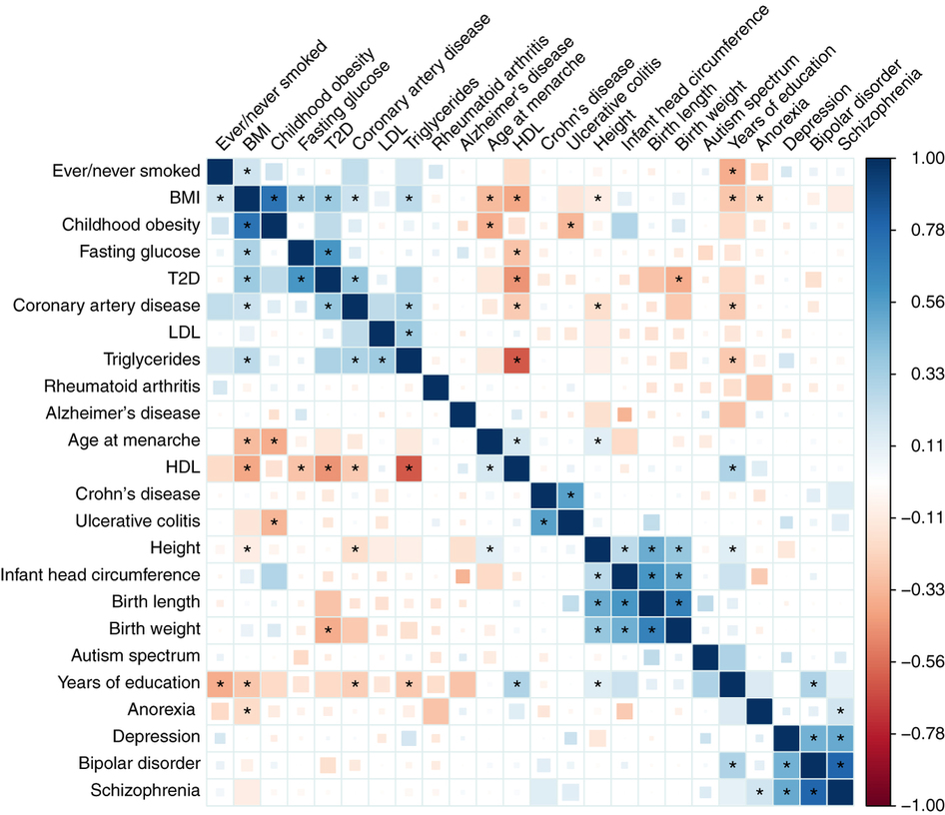

Slide 31
LD Hub
http://ldsc.broadinstitute.org/

Slide 32
Paradigms to consider
Diseases may be spectral
Asthma, high immune signature
Asthma, low immune
Aggregate SNP biomarkers may behave as more useful clinical biomarkers than individuals
Traits share genetics; more likely for certain traits to co-occur
Population level

Slide 33
Thanks!

